Slide 1
The Open School Parent Orientation
August 2022

Slide 2
The Open School History
Formed in 1971 – group of parents seeing alternatives
Used to be a primary school up to 3rd grade
Serving preschool/prek 3-5 year olds
Board of Directors
Parent involvement
Unique and amazing place
You are part of
The Open School family!

Slide 3
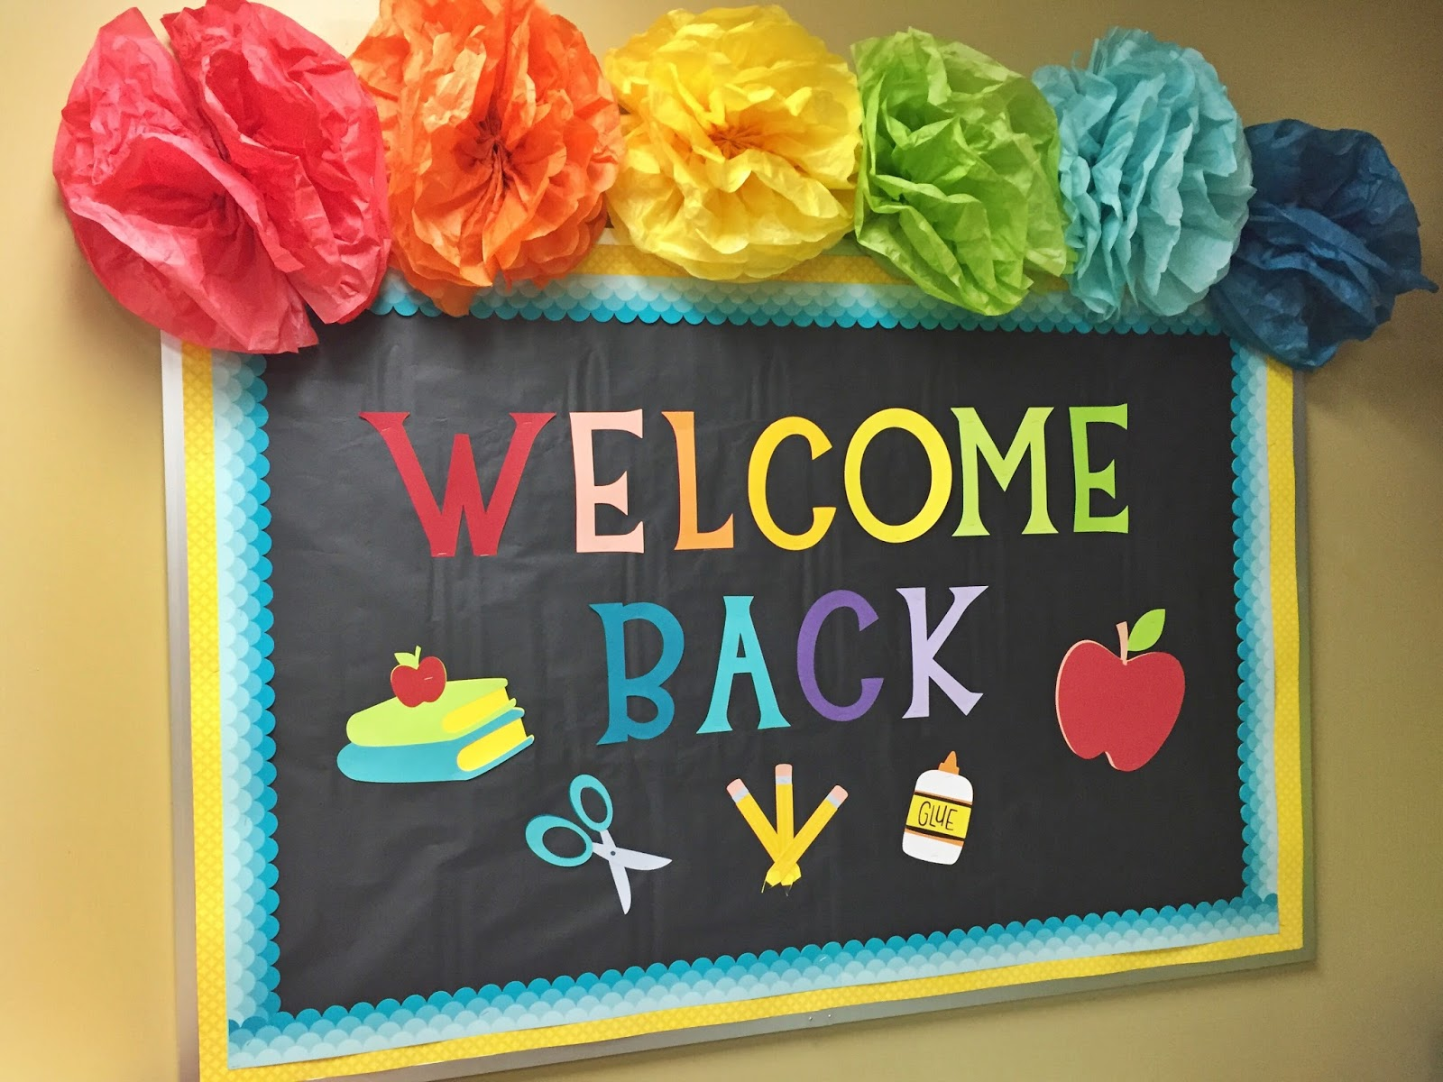
Staff: Shelly McFate – Director Laura Shuler – PreK1 Teacher/Assistant Director Joni Kern – PreK2 Teacher Reanna Schuckman- Preschool Teacher Tasen Barry, PreK1 Teacher Asst Autumn Wood – PreK2 Teacher Asst Brea Moralez – Preschool Teacher Asst Savannah Comstock – After School Director, Support Staff Taia Wickham – After School Director, Support Staff Megan Hogg – After School, Support Staff Megan McFate - After School, Support Staff Ashley Brown, Support Staff Lizzie Roth – Office Assistant, Classroom Support Chord Worden, Support Staff Robert & Natellie Jenkins- Cleaners Tamie Wick- Bookkeeping

Slide 4
Board of Directors
Delilah Pasman–President
Skiy Martin – Vice President
Kelly Carpenter – Treasurer
Christina Hutchison -Secretary
Brant Schumaker - Member
Eric Holt – Member
Davina Lockhart- Member
Board applications on website and in office
Maintenance Committee
Fundraising Committee

Slide 5
Daily School Schedule
7:20 a.m. to 8:30 a.m.
(Before School Care)
8:30 a.m. to 11:30 a.m.
(Morning Session)
11:30 a.m. to 12:30 p.m.
(Lunch)
12:30 p.m. to 3:00 p.m.
(Afternoon Session)
3:00 p.m. to 5:30 p.m.
(After School Care)
Please let us know if your child will be absent – app, email, call
No bell, but morning session carpet time generally starts by 8:45 once we get going in the year

Slide 6
Grace Period
Grace Periods are as follows:
Before School 7:30-8:30
No earlier than 7:20 a.m. or 10 minutes prior
Morning Session 8:30 a.m. – 11:30 a.m.
No earlier than 8:15 a.m. or 15 minutes prior
No later than 11:38 a.m. or 8 minutes after
Lunch Session 11:30 a.m. – 12:30 p.m.
No earlier than 11:22 a.m. or 8 minutes prior
No later than 12:38 a.m. or 8 minutes after
Afternoon Session 12:30-3:00
12:30 p.m. - 3:00 p.m. No earlier than 12:22 p.m. or 8 minutes prior
No later than 3:15 p.m.or 15 minutes after
3:00-5:30
Not available

Slide 7
Monthly Schedules
One-month notice to change schedules
Add on sessions – may or may not be available – see Shelly to check class ratios
We have a little bit of flexibility in schedules. See Shelly if you need to add a session on random days.
Pay for added extra sessions the following month
If you have a schedule change right now, see Shelly
Enrichment – let you know when added

Slide 8
Tuition Policy
The Open School is a non-profit organization.
Tuition is based on a yearly amount and is prorated over nine months Sept-May
Tuition payments –statements in cubbies, due between 1st-10th of each month, late fees will be applied daily after 10th
Schedule changes/withdrawal notice 30 days notice
No discount for missed days due to illness, vacation, etc.
No make-up days for missed days due to illness, vacation, etc.
No flexing of schedules – it is a monthly schedule, can be changed for the next month by visiting with Shelly to see availability to increase schedule or notify in writing to decrease schedule
Extra session fee $25, add a lunch $10
Pick up or drop off outside of package 25 cents a minute
Discounts for siblings, prepay semesters, or military families
Child Care Aware for military families
DFS assistance for those who qualify

Slide 9
Tuition Payment Options
Check
Pay by check – black box in office by bulletin board
Pay with cash
Cash – see Shelly or staff for receipt
Auto Draft
Pay by auto-draft - $1/month, out on 5th
Forms were emailed, also available in office
Credit
Online credit card – 2.75% transaction fee applied at end of month
Prepay
Pay in office with credit card, 2.75% fee card swipe
Discount of 2.5% if prepay by the semester
Let Director know to bill that way (4 months first, 5 months second semester)
Must be paid by September 10 and January 10 for discount
Cash
Last year auto draft still active – unless you change or stop it
You will still get a statement to review prior to the 5th

Slide 10
Enrollment and Supply Fees
$40 supply fee each semester (September & January charges)
$60 annual enrollment fee each year
Will be on first tuition statement in September if haven’t prepaid
Personal items such as water bottle, change of clothing, etc. were listed in newsletter

Slide 11
Meals and Snack Time
Lunch Time (avoid glass containers, red dye – new floors)
Water Bottles
Label snacks please
Morning Snack Time (can bring in more than 1 day at a time and leave in cubby or refrigerator)
After School Snack Time
Allergies
Miss Joni’s room allergy nut allergy (morning snack)

Slide 12
Celebrations
Birthday Treats – check with teacher on amounts, allergies
Holidays – we will celebrate and have class parties for holidays – watch for sign-up sheets for special occasions
Summer birthdays – check with teachers, not all in May please
Events - tbd

Slide 13
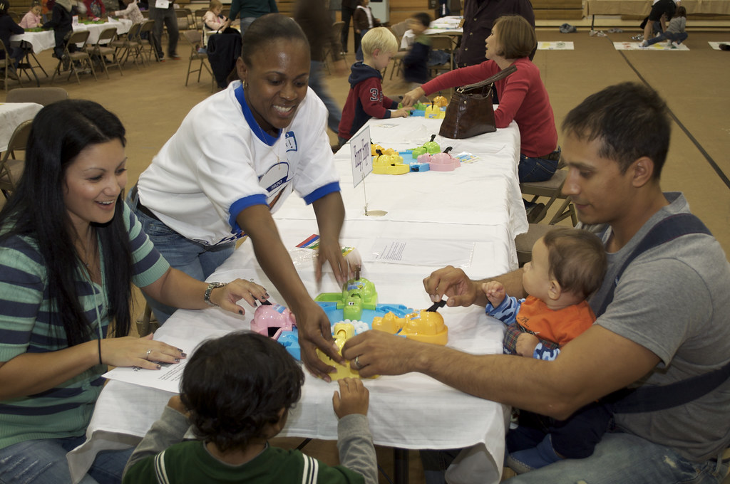
Family Nights & Events
Peppermint Parade
Art Show
Graduation
Family Nights

Slide 14
Creative Curriculum
(1) blocks;
(2) dramatic play;
(3) toys and games;
(4) art;
(5) library;
(6) discovery;
(7) sand and water;
(8) music and movement;
(9) cooking;
(10) technology; and
(11) outdoors. Separate interest areas with varied materials offer children a clear range of choices.
Children learn through play!

Slide 15
Enrichment
Music – looking for teacher
Fitness: Soccer, PE with UW
On Site – art, cooking, science
Spanish
Library, UW art museum, field trips
Other enrichment will be added as we are able - working on swimming
Enrichment add-ons available first to fulltime students, then limited spots for part-time students

Slide 16
Field Trips
The “Permission Slip for Field Trips” must be completed when students begin school.
Attending with child who doesn’t normally attend that session – discuss with the teacher. If a parent attends with a child – no charge, if we have room for child to attend without parent, then charged session fee. This only applies to field trips, not regularly scheduled enrichment offerings.
If parents prefer that their child not participate in a field trip, the parents are responsible for arranging other care for the child that day.
Arrive on time

Slide 17
Current Procedures
Drop off – drop off on playground or in classroom if still inside
Check in/out on phone with ProCare App
Picking up – on playground or in classrooms
Before/After school – in Miss Laura’s classroom
Lunches/snacks – may eat outdoors or indoors

Slide 18
If cones are out, reserve for vans
No U-turns please
Please do not block neighbors
Walk children to/from classroom or playground and check in with teacher on clipboard, as well as on ProCare app
Pick-up/Drop-off

Slide 19
Tears & Anxiety
*Honeymoon period
*Staff can assist
*We will let you know that they have calmed
*Positive parent regulation
*Solutions if ongoing
*We recognize this is
first experience for
some children

Slide 20
ProCare
App – Pro Care Engage
Download app – invites sent to parents’ emails
Each parent should download app
Will be used to send reminders, photos, communication about our day
Contactless Check In/Out
Other people picking up or dropping off – manually check in/out with notebook
App only works through the invite email
Communicate with teachers through the app (privately)
See Shelly for help with app

Slide 21
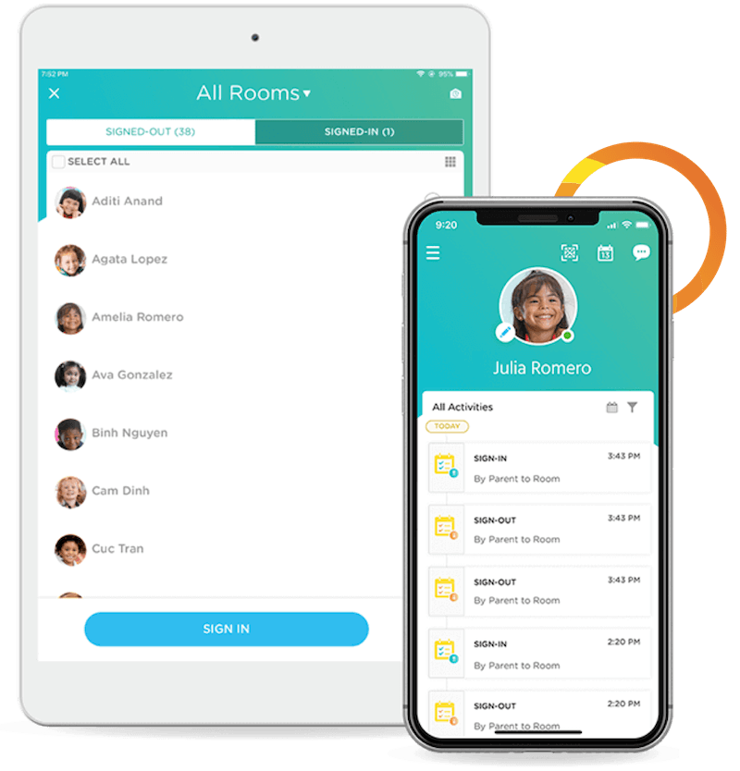
ProCare Engage
Procare Engage
Contactless Check In and Out – GeoFence
Open App – QR code symbol right top, prompted that you are at the school, check in/out
Signature at check in

Slide 22
Release of Child to Non-Parent Or Guardian: *Parent/Guardian Complete Release Form *They must be on release form *They must bring ID *Check in/out manually with staff

Slide 23
Sunscreen
If your child should use only their own bottle, please talk to teacher, label their personal bottle, and give to teacher
Face stick – individual use
Spray bottles – shared unless told otherwise
Helpful to arrive sun screened at drop off during warm weather

Slide 24
Playground
Walk children to/from – red line
Staff at gazebo check in
Playground rules taught to children
End of day and beginning of day – smooth transition time
Please make sure siblings are supervised –mixed ages playing
Keeping children safe #1 job
Rocks/sand/mulch left in proper areas
Shoes fill with sand – sneakers are great!

Slide 25
Bike Path
Bring helmet, fitted, labeled – must be worn if riding
Bike path closed at drop off recess and when weather dictates
Bringing own bikes
No walking on path if riders are present
No pushing trucks on path

Slide 26
Clothing
Labeled please
Comfortable clothing
Please send hats, coats, mittens, boots, and shoes for students to change into in cold weather
Extra change of clothes
No pull-ups
Slippers/indoor shoes
Lost and found in office
Bathroom accidents
Sneakers left here for walking, PE, etc.

Slide 27
COVID-19 Policies
Will follow public health and CDC guidance
https://www.cdc.gov/coronavirus/2019-ncov/community/schools-childcare/k-12-childcare-guidance.html
Policies subject to change – community levels and/or outbreaks
Vaccinations
Ventilation
Handwashing
Staying home if sick in general – follow sick policies in handbook
Cleaning and sanitation
Isolation - staying home if positive – 5 days, 5 days masked
Exposed – let school know, will seek guidance (vaccination status, masks, classroom status, etc.)
Sending home, recommending testing if symptomatic at school
Free tests -https://www.covid.gov/tests
Insurance reimbursement tests

Slide 28
Illness Policy
Illnesses are outlined in parent handbook
All illnesses: 24 fever free without medications, symptom free
COVID-19 symptoms – check with child’s doctor, testing
Deemed another illness – see handbook for policies
If someone in household has been diagnosed or exposed, comply with public health orders for isolation/guarantine/testing (do not attend school until released)
Teachers will call parents immediately and send a student home if they observe symptoms of illness during the school day. Need to have children picked up asap (within 30 minutes).
If the child requires antibiotics for treatment of any illness, please keep the child out of school until the child has been on the antibiotic for a minimum of 24 hours.
If not well enough to participate in scheduled activities – recess, swimming, etc, then not well enough for school – no extra staff to monitor indoor recess or one child sitting out of swimming, etc.
Exceptions – see Director if short term accommodations are medically

Slide 29
Illness Notification
We will notify parents of a contagious illness.
Please notify the school if absent and reason.
When any reportable communicable diseases occurs and teachers, staff, or students have been exposed, the School shall immediately advise all staff and parents to allow them to observe for symptoms. The specific identify of the person(s) infected shall not be revealed except to authorized health authorities if required by law.
(Communicable diseases listed in handbook, to include COVID-19). Contact tracing by public health would occur.

Slide 30
Medication Administration
Medication Administration Request
Complete Instruction
No medication in cubbies or backpacks – including hand sanitizer, chapsticks, lotions, etc – talk to teacher about storage of products
Certified staff will administer
Asthma inhalers, epi-pens – check these items in with Shelly

Slide 31
Parent Responsibilities
Volunteer
Help Fundraise
Read Parent Handbook
Turn in All Required Forms (notes in cubbies with anything missing)
Returning families – enrollment update form
Attendance
Comply with school policies
Communicate with teachers/director
Read information – newsletters, emails, messages

Slide 32
Communication
Parent-Teacher Conferences
School Calendar
Newsletters
Facebook Laramieopenschool
Website The website address is: www.laramieopenschool.org
School Alerts will be posted on website
Teacher/Director e-mail - available from 8:00 a.m.-5:00 p.m.
ProCare app

Slide 33
Discipline Policy
The Open School focuses on positive guidance, such as redirection, natural and logical consequences, modeling of positive behavior, and other non-punitive methods of discipline. Teaching self regulation and social and emotional skill development is part of our curriculum and a goal of preschool education.
Conscious Discipline
Dr. Becky Bailey – Conscious Discipline website, FB, YouTube
Social/emotional regulation first step and important piece of preschool

Slide 34
On-Going Discipline Issues
!) The problem will be discussed with the child to select an alternative behavior option. Should the behavior continue…
2) The problem will be discussed with parent(s) and staff with face-to-face communication. Should the behavior continue…
3) The problem will be addressed in a formal meeting with parent(s) and all other staff members. At the meeting, a written action plan will be developed with required approval of the staff members. This plan of action should ask for an appropriate level of involvement from the parent(s). Should the behavior continue…
4) The Board of Directors will be contacted and will meet with the staff member(s) and parent(s) to discuss options and address the problem. The Board will review the situation and make its recommendations for resolution. The child may be suspended or the parents may be asked to withdraw their child from the program.
If a child is exhibiting disruptive behavior to the point that is disturbing the students or creating a dangerous situation, the parent(s) will be called to the school to remove the child immediately.

Slide 35
Additional Policies
WEAPONS POLICY
TOBACCO/ALCOHOL/DRUG POLICY
ANIMAL POLICY

Slide 36
Picture Days
Spring & graduation portraits

Slide 37
Drills
Fire
Tornado
Snow Days
Gas Leaks/Other
Lock Down Procedure
Active Shooter

Slide 38
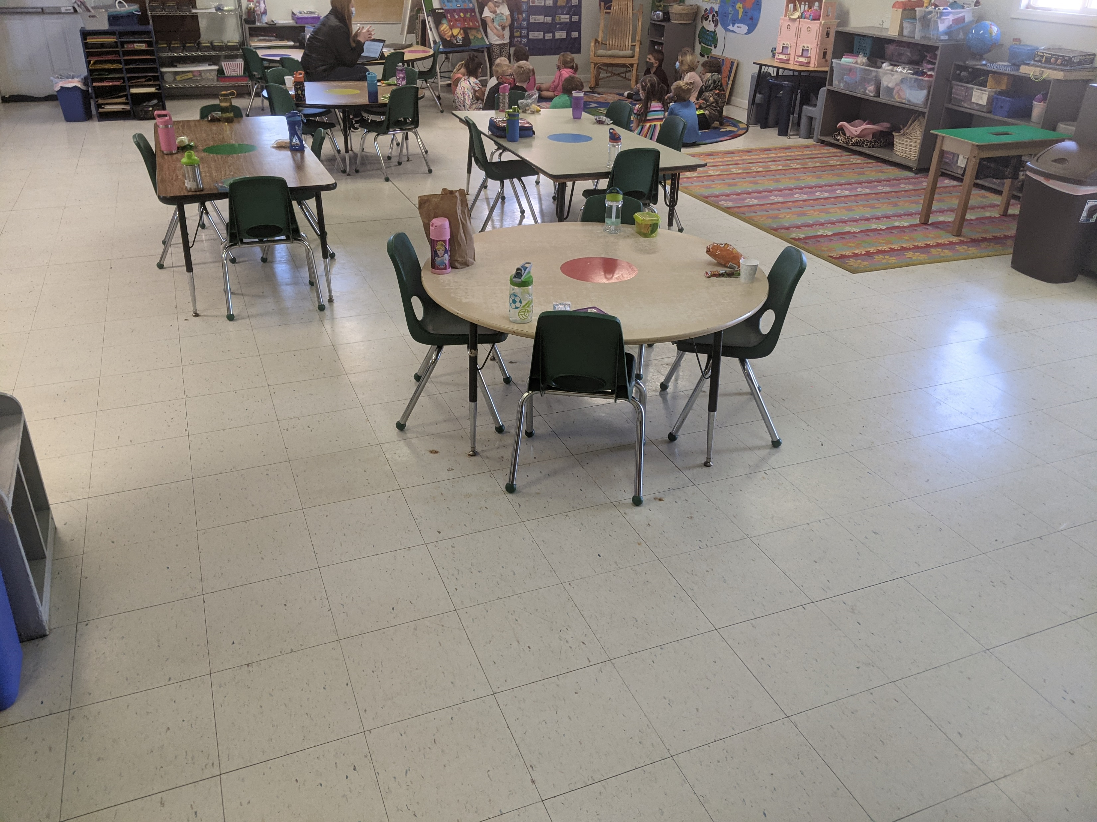
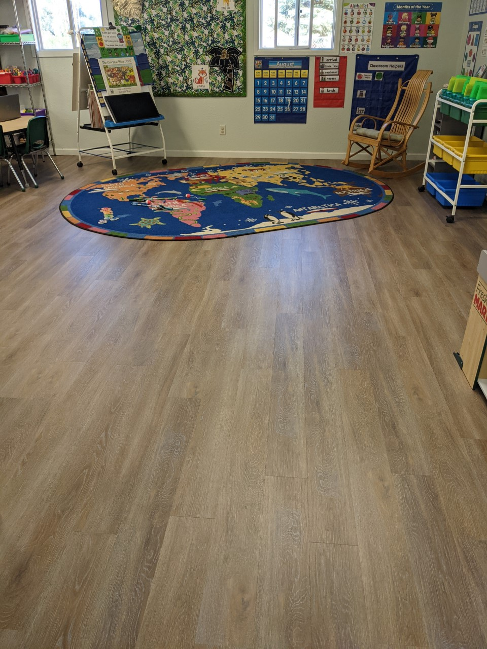
Fundraising Committee
Popcorn Fundraiser – before Christmas
WyoGives day – July 13 – matching donors
Amazon Smile
smile.amazon.com
Other fundraisers – events, raffles, etc.
Scholastic Book Fairs – 2x a year (virtual this fall)
New floors, vans, bike path, equipment, toys, shed, furniture, rugs, supplies

Slide 39
Maintenance
UW Big Event October 8th morning
See Shelly if you like to do yard work, move snow, have repair & maintenance skills

Slide 40
Questions?
Open House 8/23 Tuesday
9:00 – noon
Meet the teacher, bring supplies, see you there!
We are excited to return to more normal operations, and welcome families back. Thank you for your grace and cooperation. We will do our best to keep you informed and involved.

